Slide 1
CAR Calibration Meeting CAR Review
AP Team
Funny Li, Tony Hsu and Ronald Tse
September 2013

Slide 2
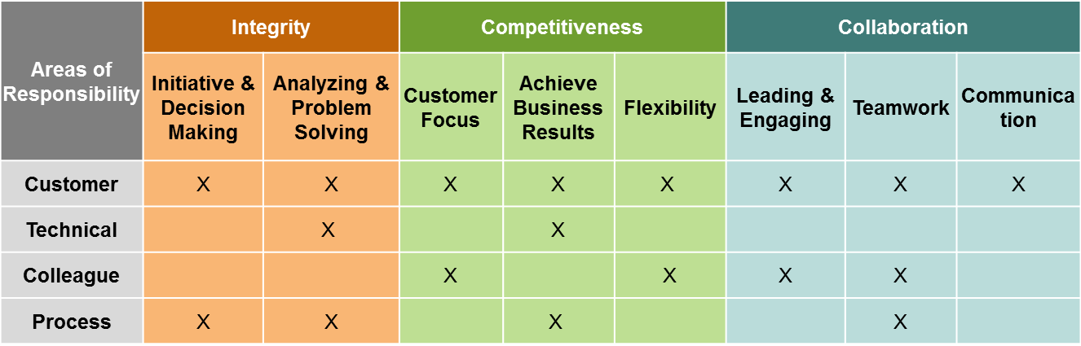
CAR Champion Critical Behaviors for Success
Alignment with Critical Behaviors for Success and UL Values
CAR Champion, Areas of Responsibility:
C – Customer; T – Technical; L – Colleague; P – Process.
Notes:
EIGHT (8) CBS attributes :-
(CAR Champion, Areas of Responsibility: C – Customer; T – Technical; L – Colleague; P – Process)

Slide 3
Study for CAR# 123911950

Slide 4
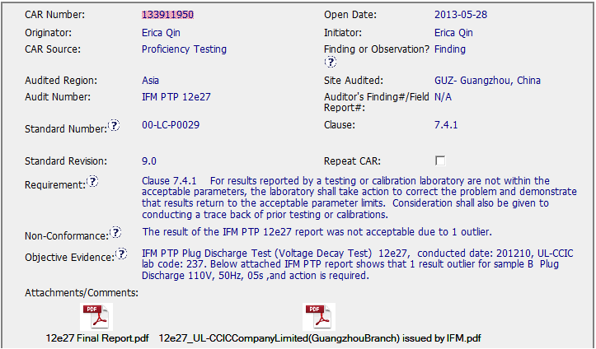
CAR# 133911950

Slide 5
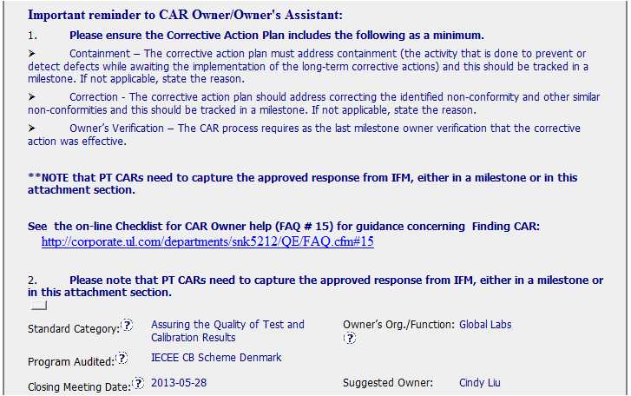
CAR# 133911950
Special Remind for IFM PT CAR
[Collaboration] (C L) Evidence of communication for other pertinent concerns – Yes

Slide 6
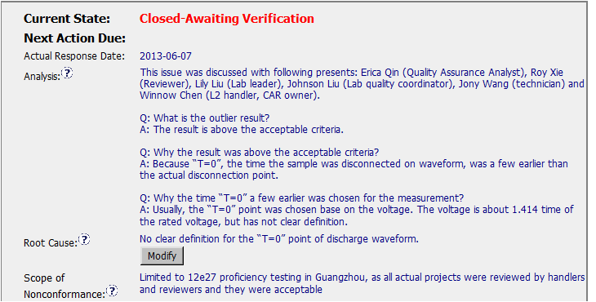
CAR# 133911950 – Analysis
Suggest to provide more clear statement to identify the correct definition and wrong definition applied in PTP
[Competitiveness] (C) Analysis shows clear path to root cause and scope; stakeholder identify – Yes
[Competitiveness] (C) Root cause statement is succinct, reasonable, complete – Yes

Slide 7
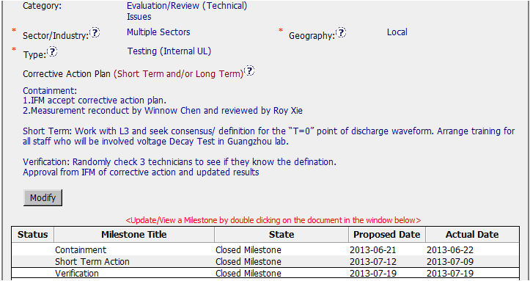
CAR# 133911950 – CAP
[Integrity] (T) Most appropriate ‘category’, ‘type’, ‘geography’ are selected. – Yes
[Competitiveness] (C) Corrective actions fix the objective evidence and other problems found; address entire root cause and scope – Yes
[Competitiveness] (C) Milestones address containment & owner’s verification – Yes

Slide 8
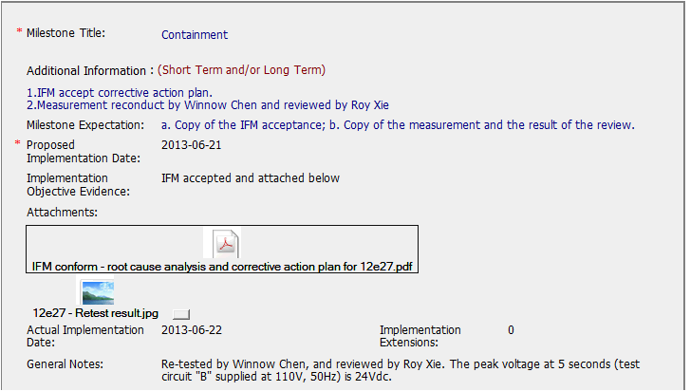
CAR# 133911950 – Containment Milestone
Clear identify the re-test results – 24V.
[Competitiveness] (C) completed per milestone expectations – No, see next page

Slide 9
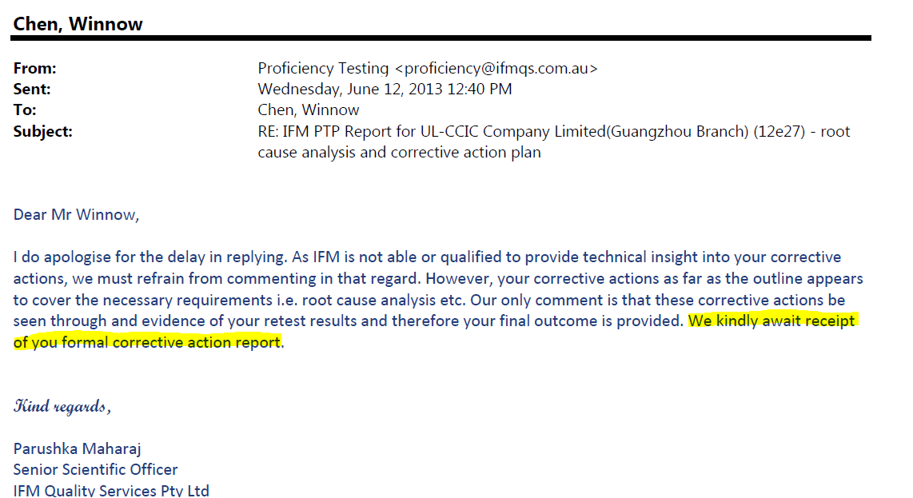
CAR# 133911950 – Containment Milestone
The evidence shows IFM await receipt of your formal CAR. NOT IFM accept it.

Slide 10
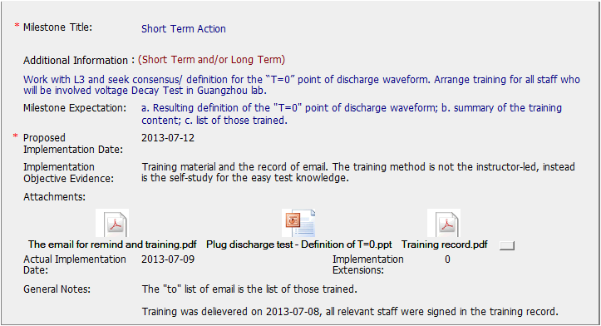
CAR# 133911950 – Short Term Action Milestone
Consider some absent staff, provide email to let them selfstudy.
[Competitiveness] (C) completed per milestone expectations – Yes

Slide 11
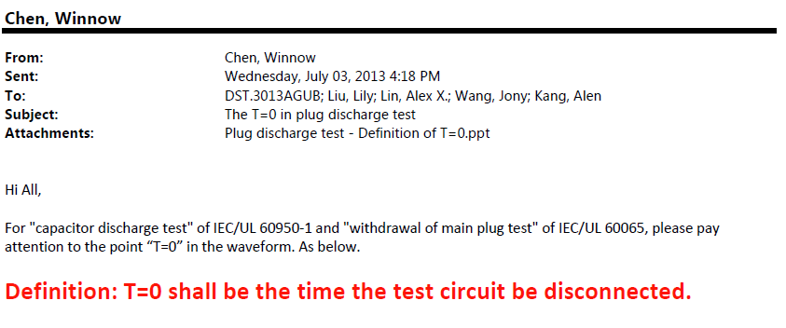
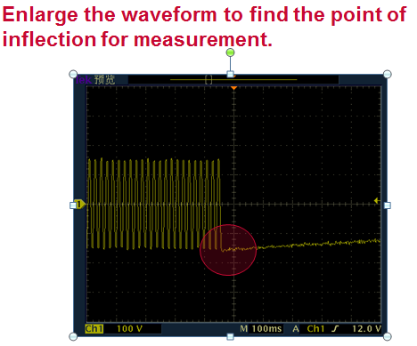
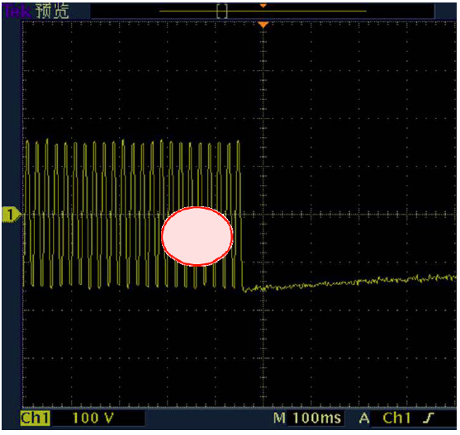
CAR# 133911950 – Short Term Action Milestone
Different diagram in classroom training ppt against email, Not consistent message for the “circle” in diagrams.

Slide 12
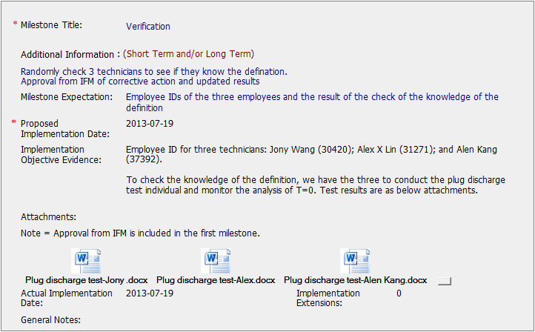
CAR# 133911950 – Verification
Each technician conduct the test to find T=0, 1s and 2s.
[Competitiveness] (C) completed per milestone expectations – Yes

Slide 13
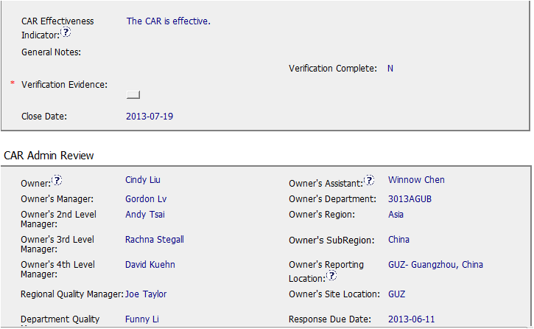
This should not be an indicator.
See FAQ 20
In addition, the CAR Effectiveness Indicator field should be completed with a brief description of what will show that the corrective action plan was successful.
[Competitiveness] (P) Verification per requirements. – No. No correct CAR Effectiveness Indicator.

Slide 14
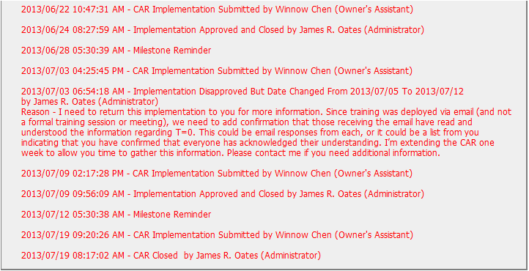
CAR# 133911950 – History
Work with Owner on implementation to cover all related staff in 2nd milestone.
[Integrity] (T) Acts on CARs within required timeframe. – Yes
[Collaboration] (C L) Evidence of communication for other pertinent concerns – Yes

Slide 15
Case Study
CAR 1 – Chris Nicastro Review – Chris Nicastro to discuss
CAR 2 – Julianne Heinzinger Review – Chris Nicastro to discuss
CAR 3 – Gunsimar Paintal Review – Dale Hendricks to discuss
CAR 4 – Dale Hendricks Review – Dale Hendricks to discuss
Team:
Dale Heindricks, Julianne Heinzinger, Chris Nicastro, Gunsimar Paintal

Slide 16
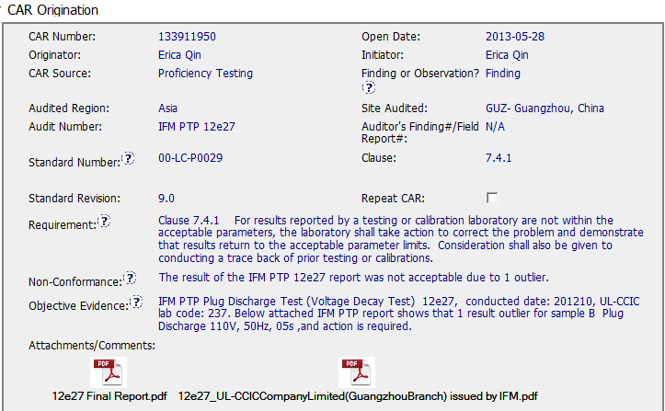
CAR – Sample 1 – CAR 133911950
Standard, Clause, and Requirement are clear
Non-Conformance is clear
Objective Evidence is detailed; it provides enough information to properly address, correct, and verify the Non-Conformance

Slide 17
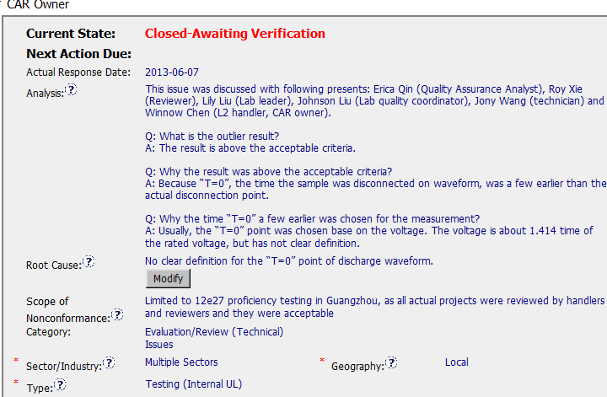
CAR – Sample 1 – CAR 133911950
Who worked on the CAR / Stakeholders - Good
Concern – Some of the answers (in the Analysis) are difficult to understand, possibly a language issue. Some editing to clarify may have helped.
Logical Drilling Down to find root cause - Good
The analysis leads logically to the Root Cause, which is clear, short, and concise.
Scope of NC is very clear, to show this is an isolated issue and help to show what is required for the Corrective Action Plan
Root Cause Category, Sector, Type, and Geography are accurate

Slide 18
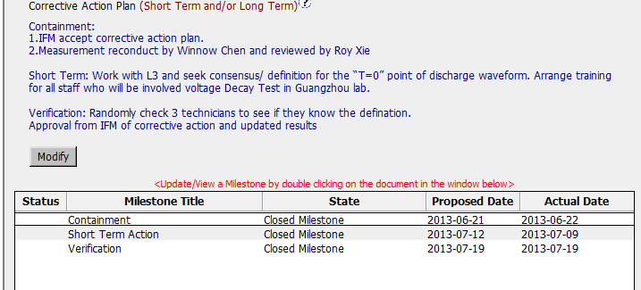
CAR – Sample 1 – CAR 133911950
Containment and Verification are addressed appropriately
Short Term Action addresses the understanding of the issue, and training
Milestones are discrete, there is no overlapping. They are clear and concise, therefore verification of each milestone is very clear.

Slide 19
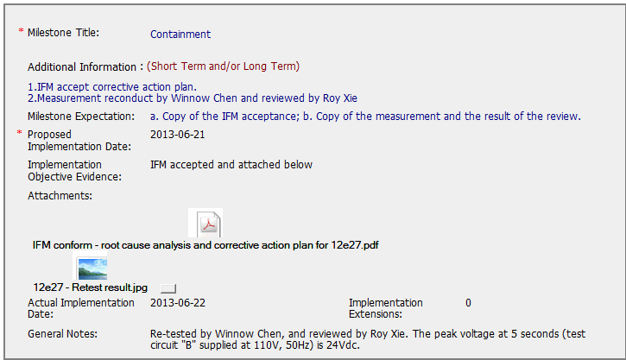
CAR – Sample 1 – CAR 133911950
Excellent Attachments, which clearly show the expectation in order to close/verify the milestone.

Slide 20
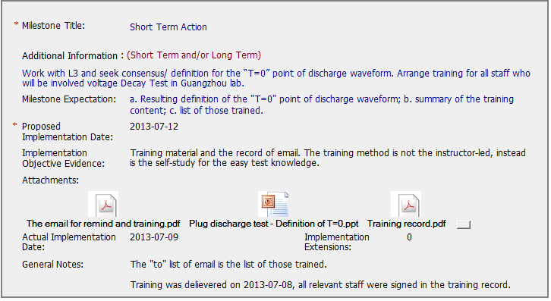
CAR – Sample 1 – CAR 133911950
Excellent Attachments, which clearly show the expectation in order to close/verify the milestone.

Slide 21
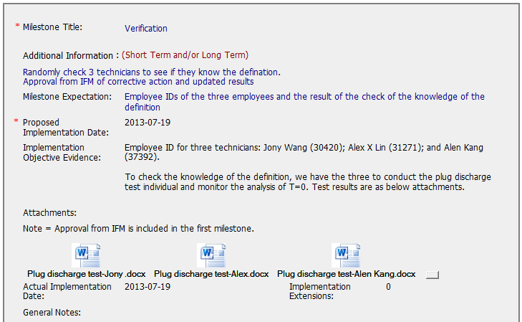
CAR – Sample 1 – CAR 133911950
Excellent Attachments, which clearly show the expectation in order to close/verify the milestone.

Slide 22
CAR – Sample 1 – CAR 133911950
Notes: Other than clarifying some sentences in the analysis, this CAR is excellent. There were not extension requested or overdue notices, and the Analysis, Root Cause, CAP, and milestones are all logical and very clear. This is a great CAR!

